Slide 1
Machine Learning

Slide 2
What Is Machine Learning?
A subfield of computer science and artificial intelligence (AI) that focuses on the design of systems that can learn from and make decisions and predictions based on data.
Machine learning enables computers to act and make data-driven decisions rather than being explicitly programmed to carry out a certain task

Slide 3
Traditional Programming
Machine Learning
Data
Computer
Output
Program
Data
Computer
Program
Output

Slide 4
Sample Applications
Identification of unwanted spam messages in e-mail
Segmentation of customer behavior for targeted advertising
Forecasts of weather behavior and long-term climate changes
Reduction of fraudulent credit card transactions
Actuarial estimates of financial damage of natural disasters
Prediction of popular election outcomes
Development of algorithms for auto-piloting drones
Optimization of energy use in homes and office buildings
Projection of areas where criminal activity is most likely
Discovery of genetic sequences linked to diseases
[Your favorite area]

Slide 5
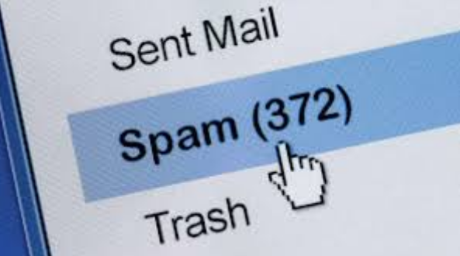
Identification of unwanted spam messages in e-mail

Slide 6

Segmentation of customer behavior for targeted advertising

Slide 7

Forecasts of weather behavior and long-term climate changes

Slide 8

Reduction of fraudulent credit card transactions

Slide 9
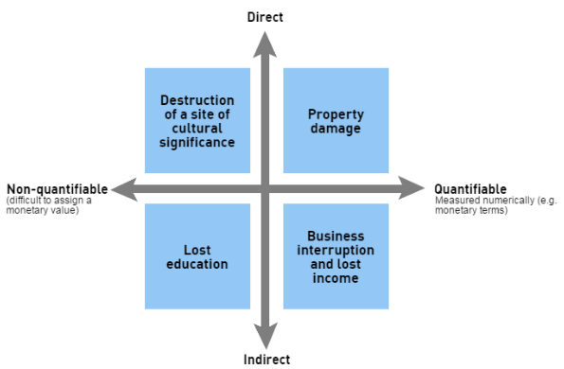
Estimation of financial damage of natural disasters

Slide 10
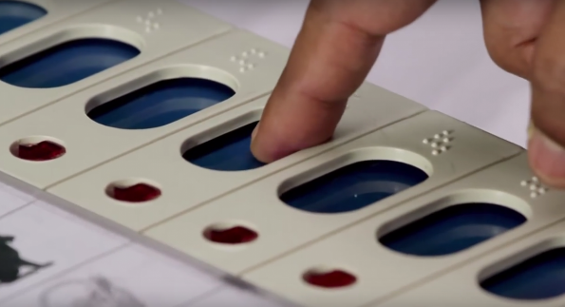
Prediction of popular election outcomes

Slide 11
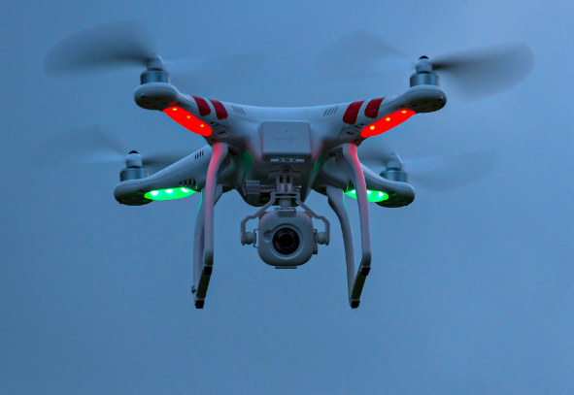
Development of algorithms for auto-piloting drones

Slide 12
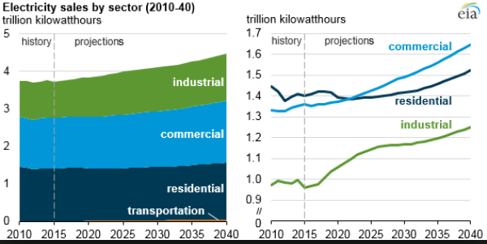
Optimization of energy use in homes and office buildings

Slide 13

Projection of areas where criminal activity is most likely

Slide 14
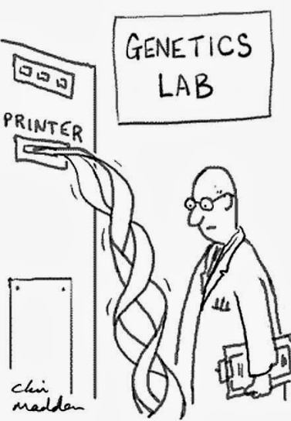
Discovery of genetic sequences linked to diseases

Slide 15

[Your favorite area]

Slide 16
ML Algorithms
Tens of thousands of machine learning algorithms
Hundreds new every year
Every machine learning algorithm has three components:
  Representation
  Evaluation
  Optimization

Slide 17
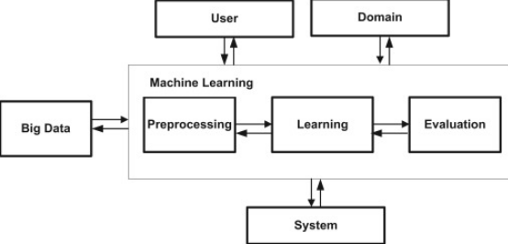
ML Model

Slide 18
Representation
Linear Regression
Nearest Neighbour
Naive Bayes
Decision Trees
Neural Networks
Support Vector Machines
Association Rules
K-means clustering

Slide 19
Evaluation
Accuracy
Confusion Matrix
Precision and recall
F1 Score
RMSE
Loss Function
Margin
Etc.

Slide 20
Optimization
Combinatorial optimization
  E.g.: Greedy search
Convex optimization
  E.g.: Gradient descent
Constrained optimization
  E.g.: Linear programming

Slide 21
Types of Learning
Supervised (inductive) learning
  Training data includes desired outputs
Unsupervised learning
  Training data does not include desired outputs
Semi-supervised learning
  Training data includes a few desired outputs
Reinforcement learning
  Rewards from sequence of actions

Slide 22
ML Algorithms Tasks
(Algorithms Grouped by its Task)
  Classification (Binary and Multiclass)
  Regression (Numeric Prediction)
  Clustering (Identifying Clusters)
  Finding Associations (Pattern Detection)
  Dimensionality Reduction
  Feature Selection

Slide 23
Feature Selection and Dimensionality Reduction
Both methods seek to reduce the number of attributes in the dataset
Dimensionality reduction method do so by creating new combinations of attributes,
Feature selection methods include and exclude attributes present in the data without changing them.

Slide 24
Supervised Learning Algorithms and their category
Nearest Neighbour -Classification
Naive Bayes -Classification
Decision Trees - Classification
Linear Regression -Numeric prediction
Regression Trees -Numeric prediction
Neural Networks -Dual use
Support Vector Machines -Dual use

Slide 25
Unsupervised Learning
A priori algorithm -Association rule Mining/Pattern detection
k-means clustering - Clustering

Slide 26
Supervised Learning
Given examples of a function (X, F(X))
Predict function F(X) for new examples X
  Discrete F(X): Classification
  Continuous F(X): Regression

Slide 27
Question
Identify 5 application areas of ML and say the task to be done by the algorithm (classification, regression, association mapping etc) and the method of learning required/possible to do the task (supervised/unsupervised)

Slide 28
Machine learning algorithm deployment steps:
1. Data collection:
2. Data exploration and preparation:
3. Model training
4. Model evaluation
5. Model improvement

Slide 29
A Few Quotes
“A breakthrough in machine learning would be worth
ten Microsofts” (Bill Gates, Chairman, Microsoft)
“Machine learning is the next Internet”
(Tony Tether, Director, DARPA)
Machine learning is the hot new thing”
(John Hennessy, President, Stanford)
“Web rankings today are mostly a matter of machine learning” (Prabhakar Raghavan, Dir. Research, Yahoo)
“Machine learning is going to result in a real revolution” (Greg Papadopoulos, CTO, Sun)
“Machine learning is today’s discontinuity”
(Jerry Yang, CEO, Yahoo)

